Slide 1
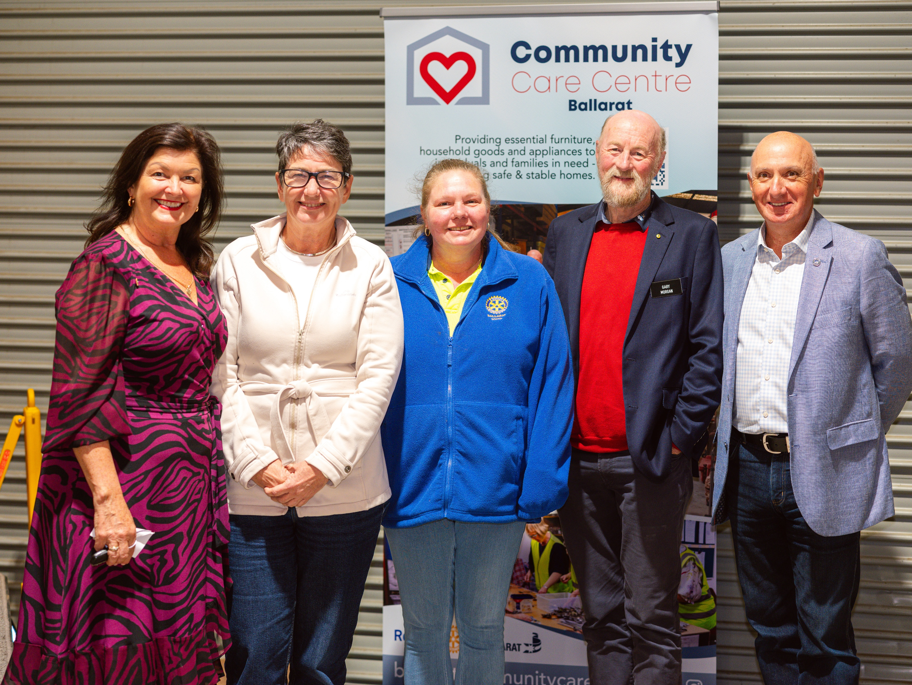

September 2026
Providing essential household goods to those in crisis, helping to rebuild lives with dignity.
Annual Report 2025-26

Slide 2
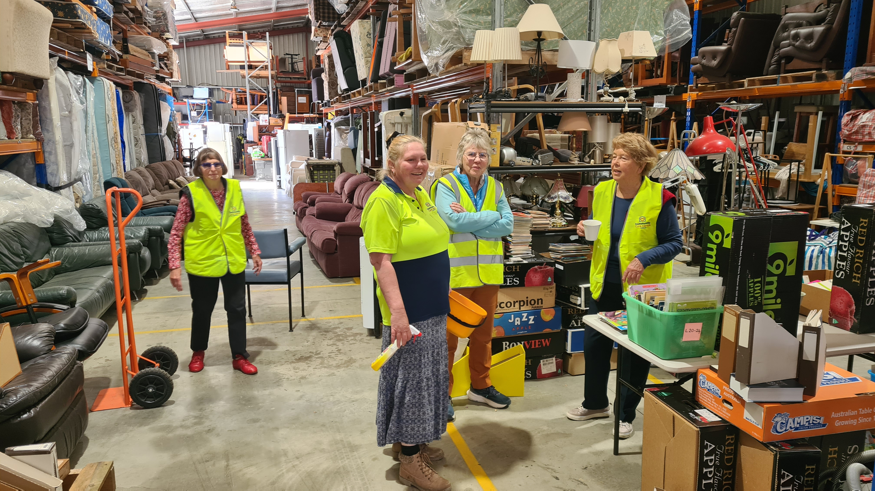
Core Objectives
01020304
Deliver quality household goods to community members in need via partner welfare organisations
Build a sustainable organisation
Create an inclusive environment
Develop meaningful partnerships

Slide 3
What we do
01 02 03
The Challenge
Helping to meet the demand for home furnishings for those escaping domestic violence, homelessness and natural disasters.
Our Response
Ballarat’s six Rotary clubs with support from the community and a wide range of local welfare organisations established a warehouse hub, acting as a collection, cleaning, storage, and distribution centre for household goods.
Volunteer Involvement
Hands‑on Rotary support in logistics and delivery

Slide 4
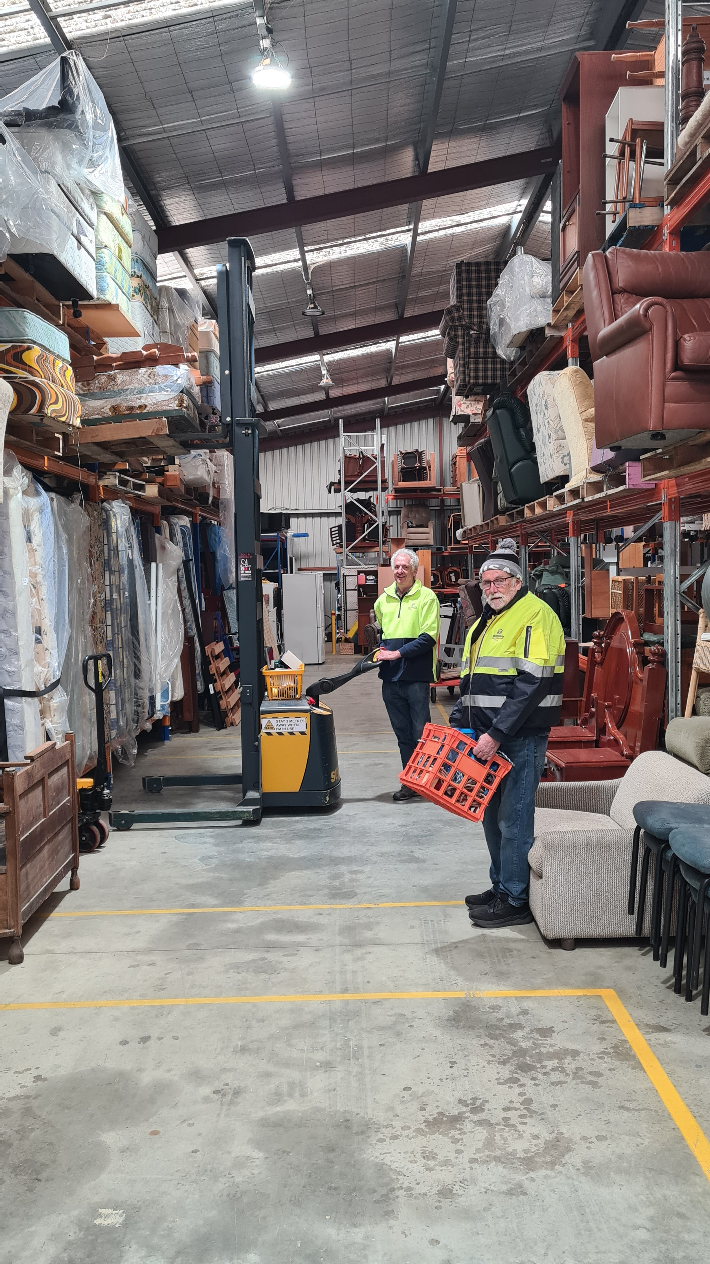
Our Process Flow
01
02
03
Collection of furniture and appliances
Cleaning, refurbishment, storage
Distribution to those in need via partner welfare organisations

Slide 5
Key Achievements
Impact Summary 25-26
Number of people assisted: 224
Number of consignments delivered: 112
Number of welfare organisations we have serviced: 19
Savings to welfare organisations: $219,576 (average value per consignment: $1960)
Time Saving for agencies: $59,673
Landfill reduced: 448 m3
Number of other not-for-profit organisations (excluding welfare organisations) serviced:17 including community opportunity shops, and international projects City of Ballarat Ainro Project, ROMAC Vanuatu Project and the Sidinda Health Clinic, Zimbabwe.
The number of volunteer hours: 3292 (Registered 3042 hours unregistered 250 hours)
Income from welfare partners: $54,894
“This year, Community Care Centre Ballarat has continued to demonstrate what can be achieved when six Rotary clubs join forces with local government, welfare organisations, volunteers and supportive donors - all working together with purpose”
Gary Morgan, Community Care Centre Ballarat Board Chairman

Slide 6
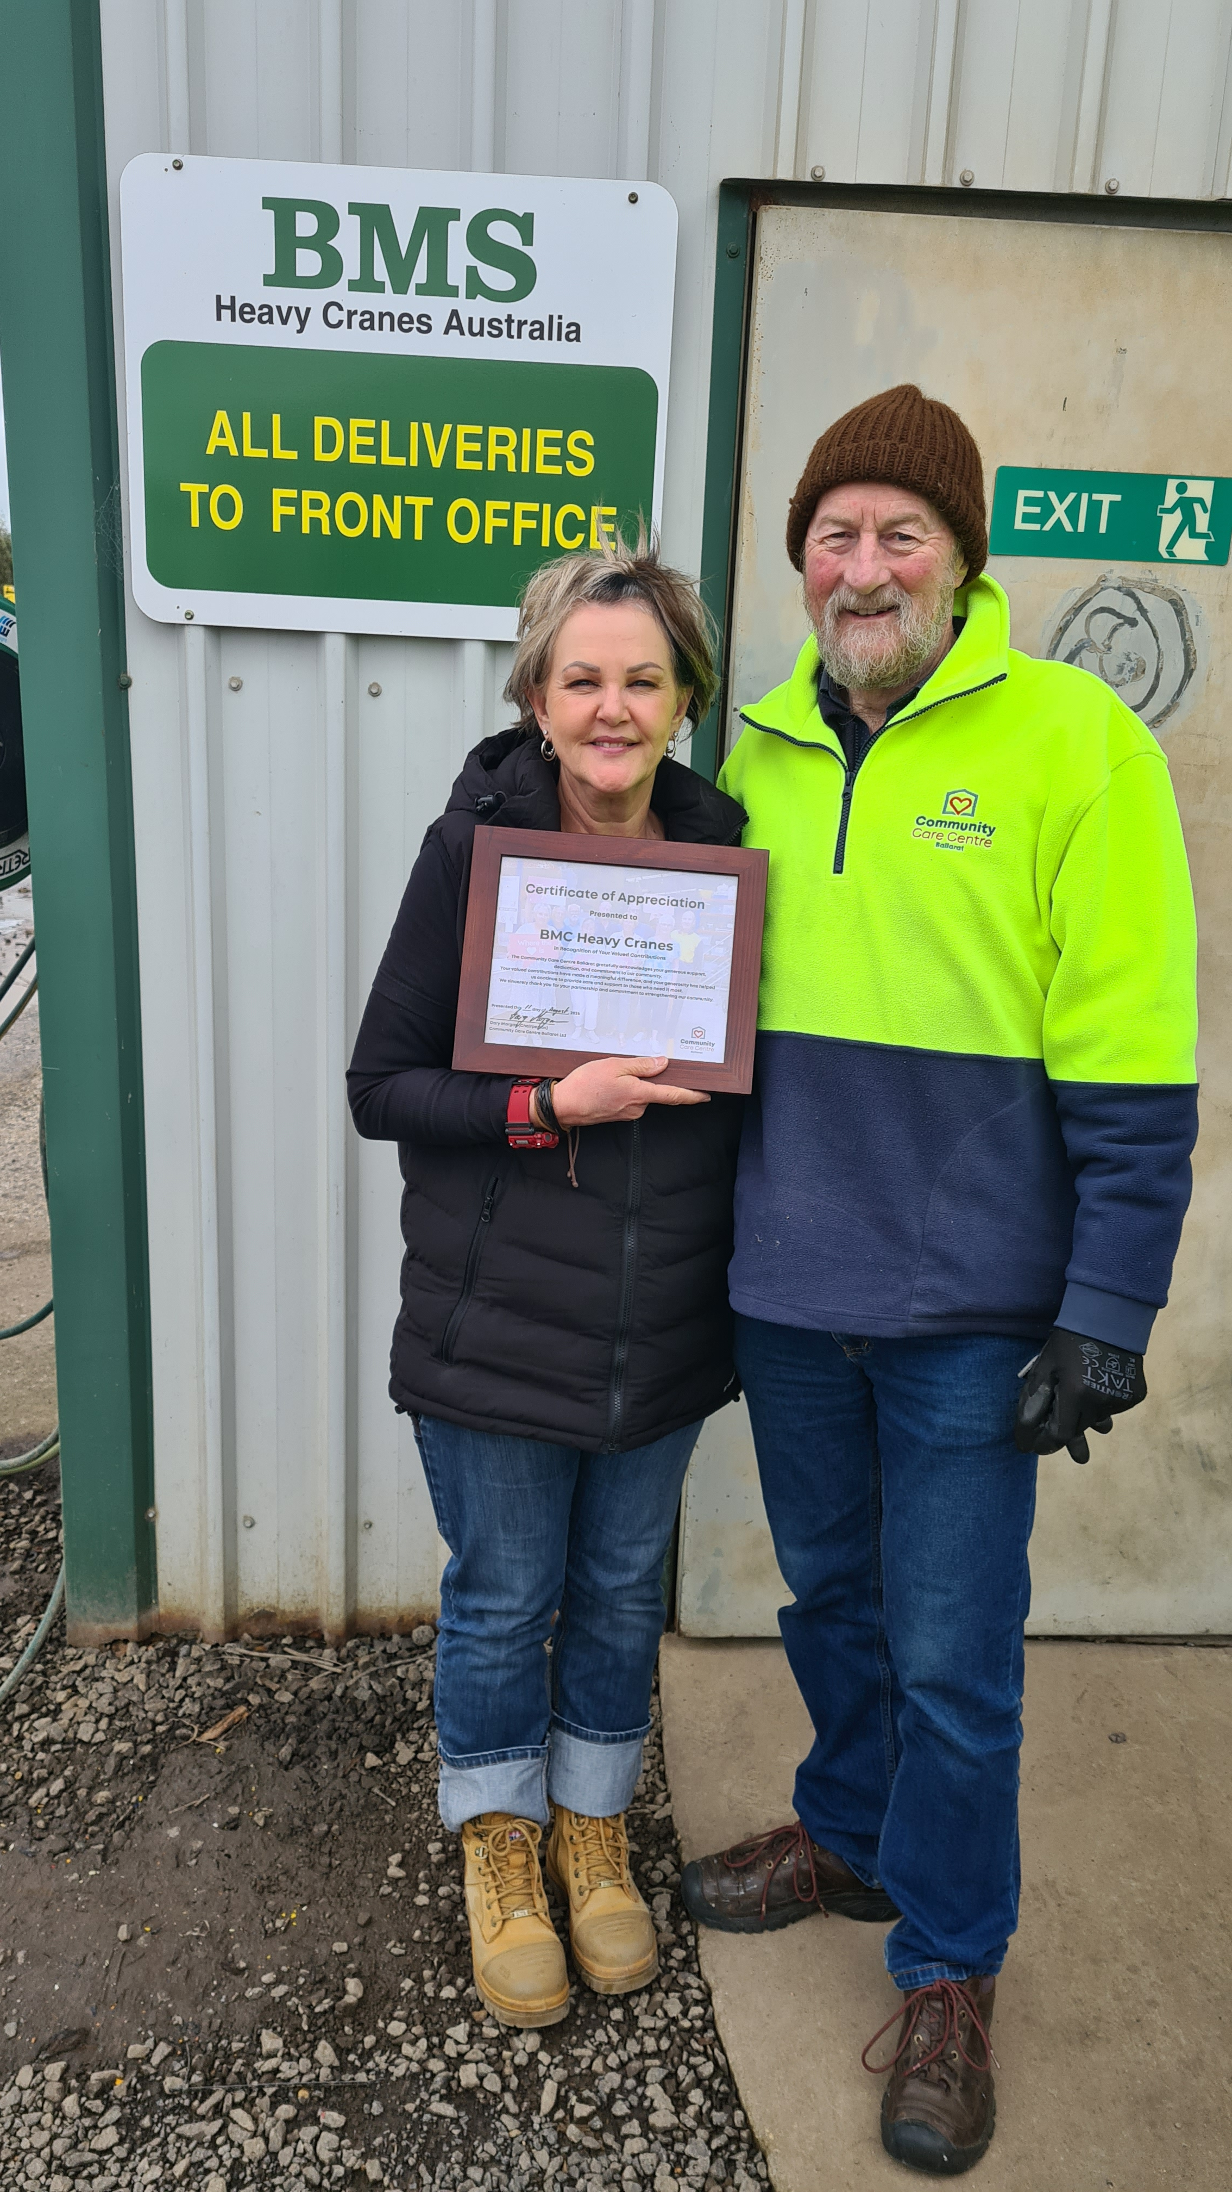
Compliance with all statutory reporting requirements ensuring we maintain our deductible gift status
Financial achievements FY26
Building a healthier, more diversified funding base as earned income from welfare organisations complemented ongoing support from our valued Partners and Financial Supporters
Ensuring our financial reporting systems remain robust and resilient to provide accurate financial reporting to our stakeholders on a timely basis.
Generating a cash surplus to fund future projects, invest in infrastructure and build reserves.

Slide 7
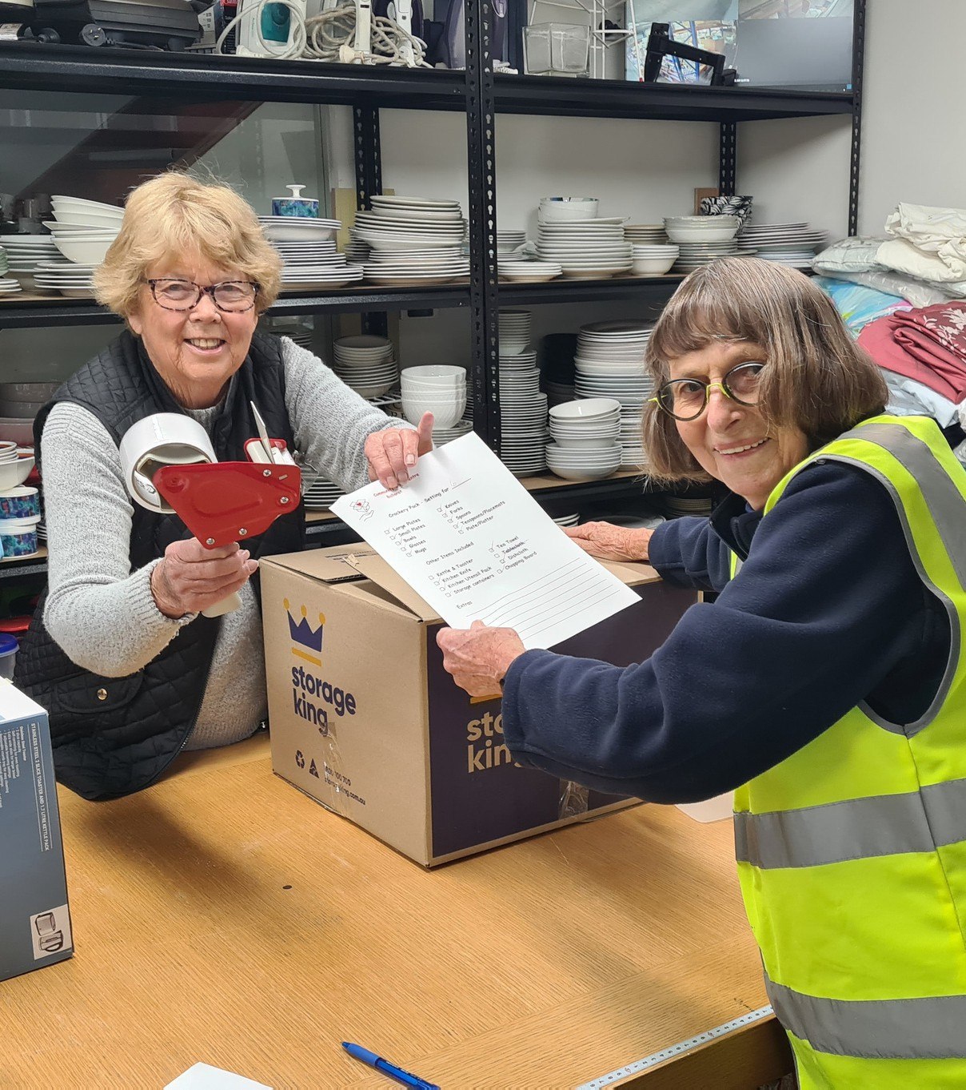
Community Impact & Success Stories

Slide 8
Case Study
Program/ Service PRAP Plus and PRAP
Client Details (Deidentified)
Jane presented to Uniting entry point and was referred to PRAP Plus. PRAP Plus commenced working with Jane in early April 2026.
Brief overview of client situation
Jane was seeking assistance primarily with housing, but several other issues were identified during the period of support.
Jane was experiencing family violence from her partner who she was residing with in a private rental. Jane was looking to separate from her partner and find private rental or other long term housing for her and her 17-year-old daughter. Jane has a number of physical disabilities and some cognitive and mental health issues. She was supported by NDIS and was not in the work force due to her disabilities.
Assistance Provided
Private rental secured through Real Estate agent.
CCCB referral for furniture and whitegoods
Advocacy with external services including NDIS and family violence services.
Financial support provided by PRAP Brokerage
Rent in advance, food vouchers, removals, rubbish removal.
CCCB Furniture Assistance provided by PRAP Brokerage
Furniture, small appliance and homewares.
Impact
With the support from PRAP Plus and being able to access the CCCB through our PRAP brokerage this meant that Jane was able to leave a violent relationship and move into her own home. It also allowed her daughter to return to living with Jane full time. Had we not been able to access CCCB Jane would have been moving into an empty property. Jane became emotional a number of times during the selection appointment at CCCB and expressed her delight in being able to choose her own furniture and homewares something she was not able to do in the past.

Slide 9
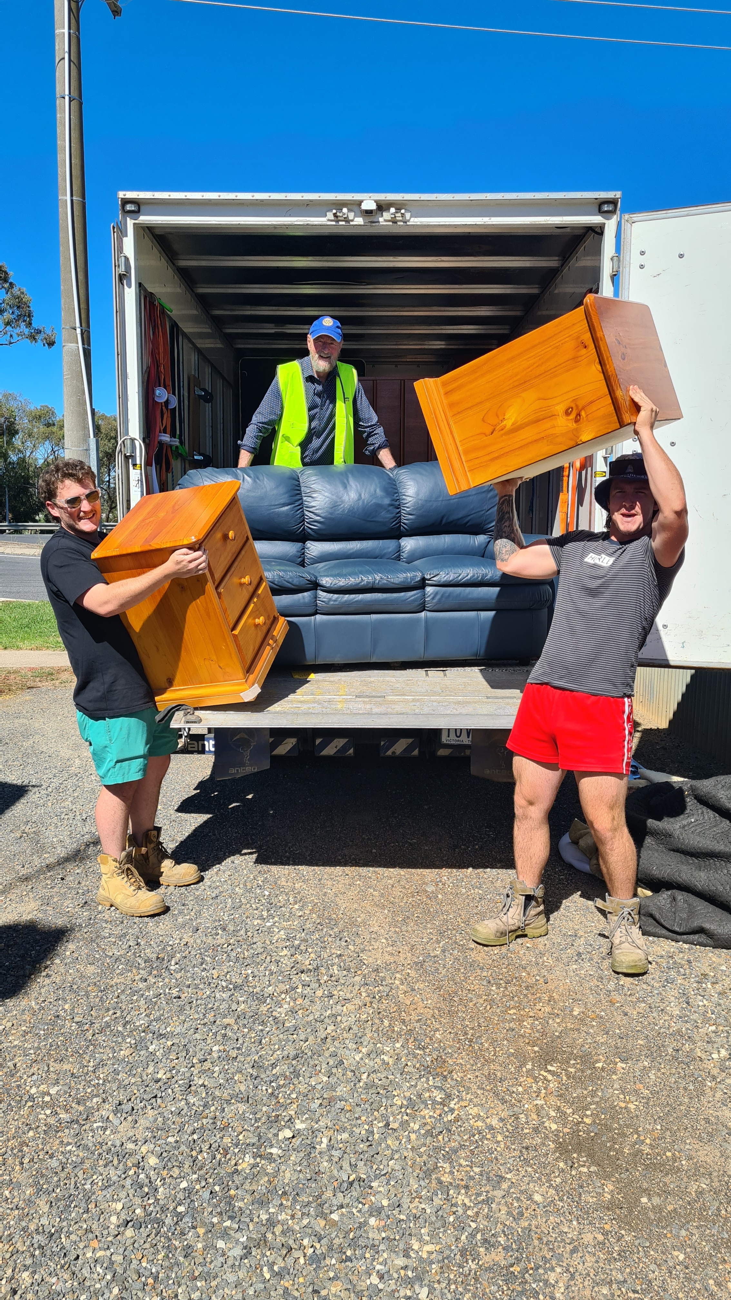
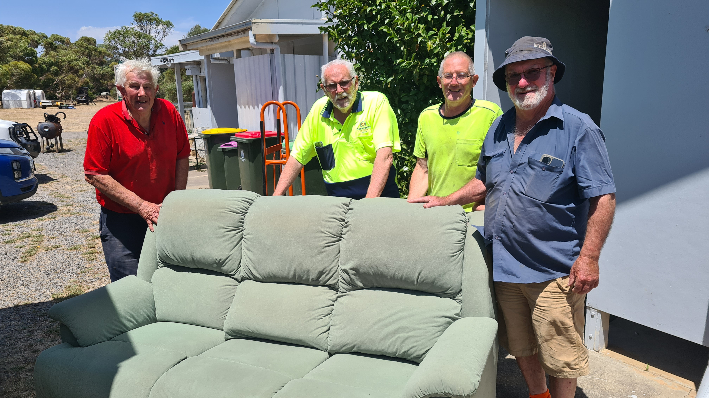
Emergency Relief and Disaster Recover
Donations from generous Rotarians assisted the CCCB to provide household items to people who lost their homes in the January 2026 bushfires and those assisting in the community recovery efforts.
CCCB helped establish the Victorian Emergency Relief Network (VERN), a statewide support network for emergency relief and recovery. VERN is a collaborative project of four organisations, all similar to CCCB (WERN, EERN and RIMERN).

Slide 10
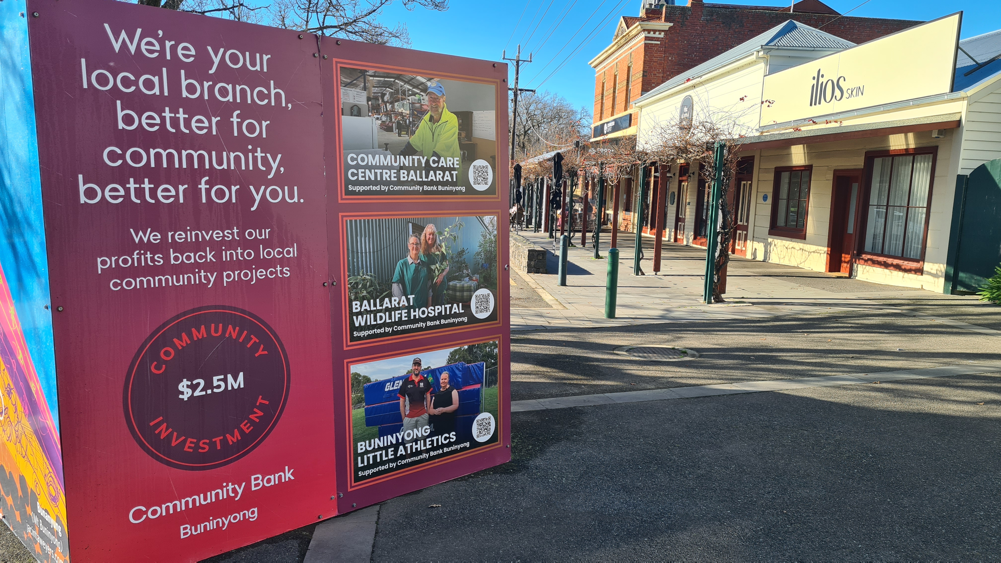
Fundraising & Partnerships 25-26
Major Partners
City of Ballarat
Six Rotary Clubs of Ballarat
  Rotary Club of Alfredton
  Rotary Club of Ballarat Inc.
  Rotary Club of Ballarat East
  Rotary Club of Ballarat South
  Rotary Club of Ballarat West
  Rotary Club of Wendouree Breakfast
Community Bank Buninyong
Jill and Andrew Oliver
Community Partners
MARS
Plus IT
Rotary District 9780
RSM
Signature Software
TJ Coutts

Slide 11
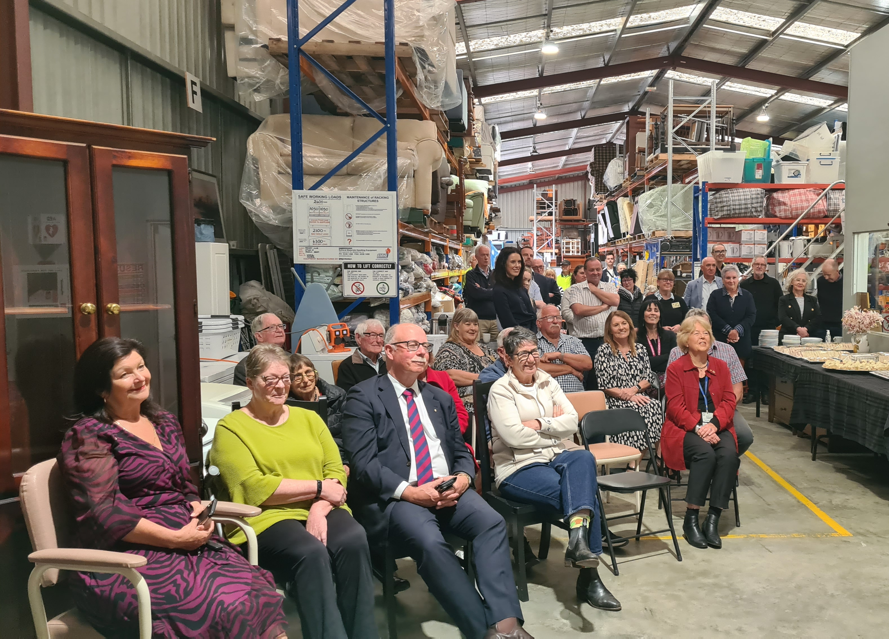
Governance & Leadership
Board of Directors
Gary Morgan AM AFS, Chair: “Rotarian, global consultant; leading strategic direction.”
Professor Warren Payne AM, Deputy Chair: “Rotarian, strategic liason to welfare organisations.”
Daryl Powell, Treasurer until 30/06/2026: “Finance professional overseeing statutory compliance.”
Rhonda Svensson, Director: “Governance lead, donor and agency liaison.”
Phil Hughes,Treasurer as of 01/07/2026: “Finance professional overseeing statutory compliance.”
01
02
Compliance & Governance Update:
Registered DGR
ACNC registration confirmed, 2024 report lodged 11 Aug 2025
Next reporting due December 31, 2026
Insurance review undertaken and covers updated
Workcover policy renewed
In Apr. ‘26 Phil Hughes join the Board

Slide 12

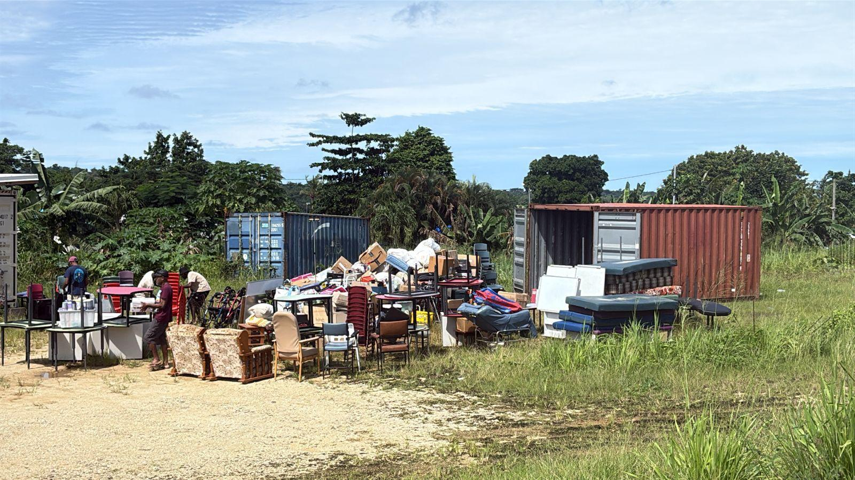
Major Challenges
Securing permanent warehouse facilities to strengthen financial security
Partnering with welfare agencies to secure sustainable income streams to meet increasing demand
Recruiting sufficient and capable volunteers

Slide 13
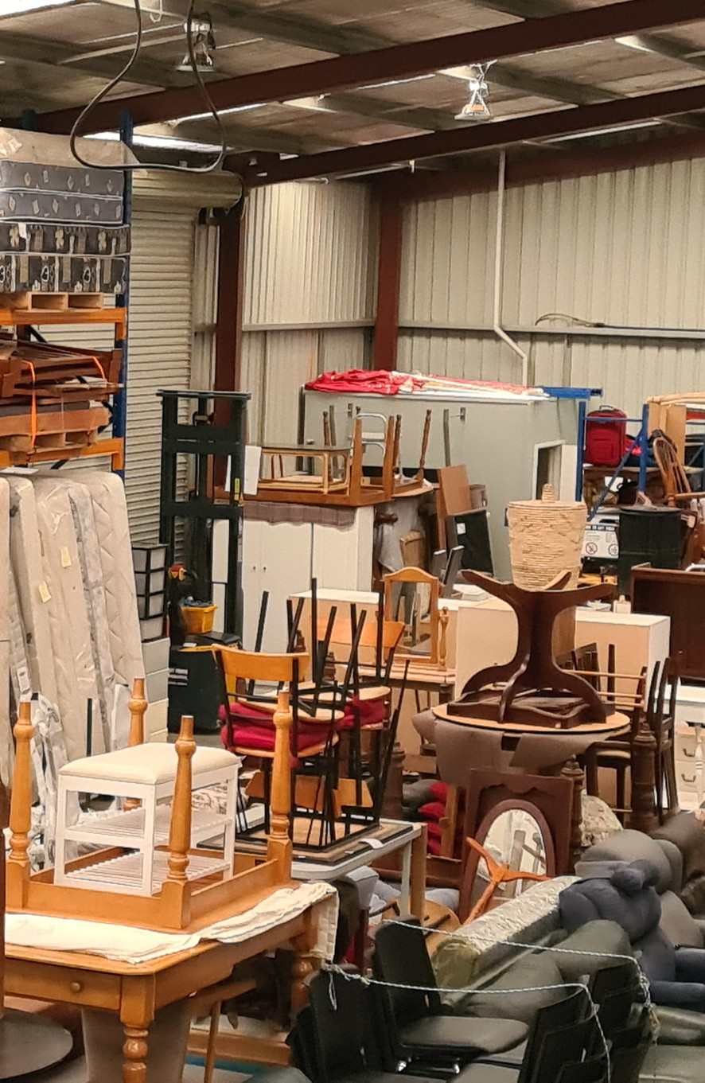
Strategic Outlook & Key Goals
01
Financial: Continue to improve the financial security of the business (including warehouse purchase)
02
Financial: Ongoing diversification of funding streams including access to funding from community and philanthropic agencies
03
Profile: Enhance our public profile
04
Volunteer frameworks: Increase our pool of volunteers

Slide 14
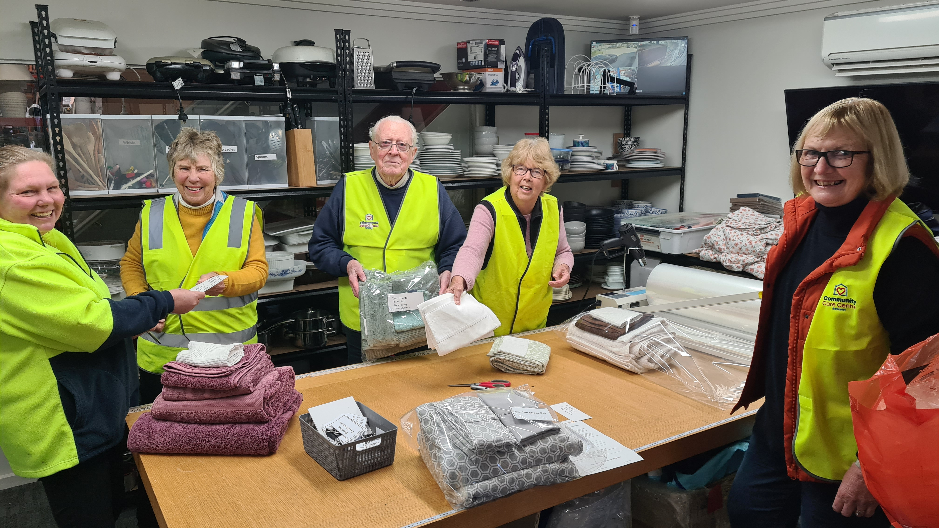


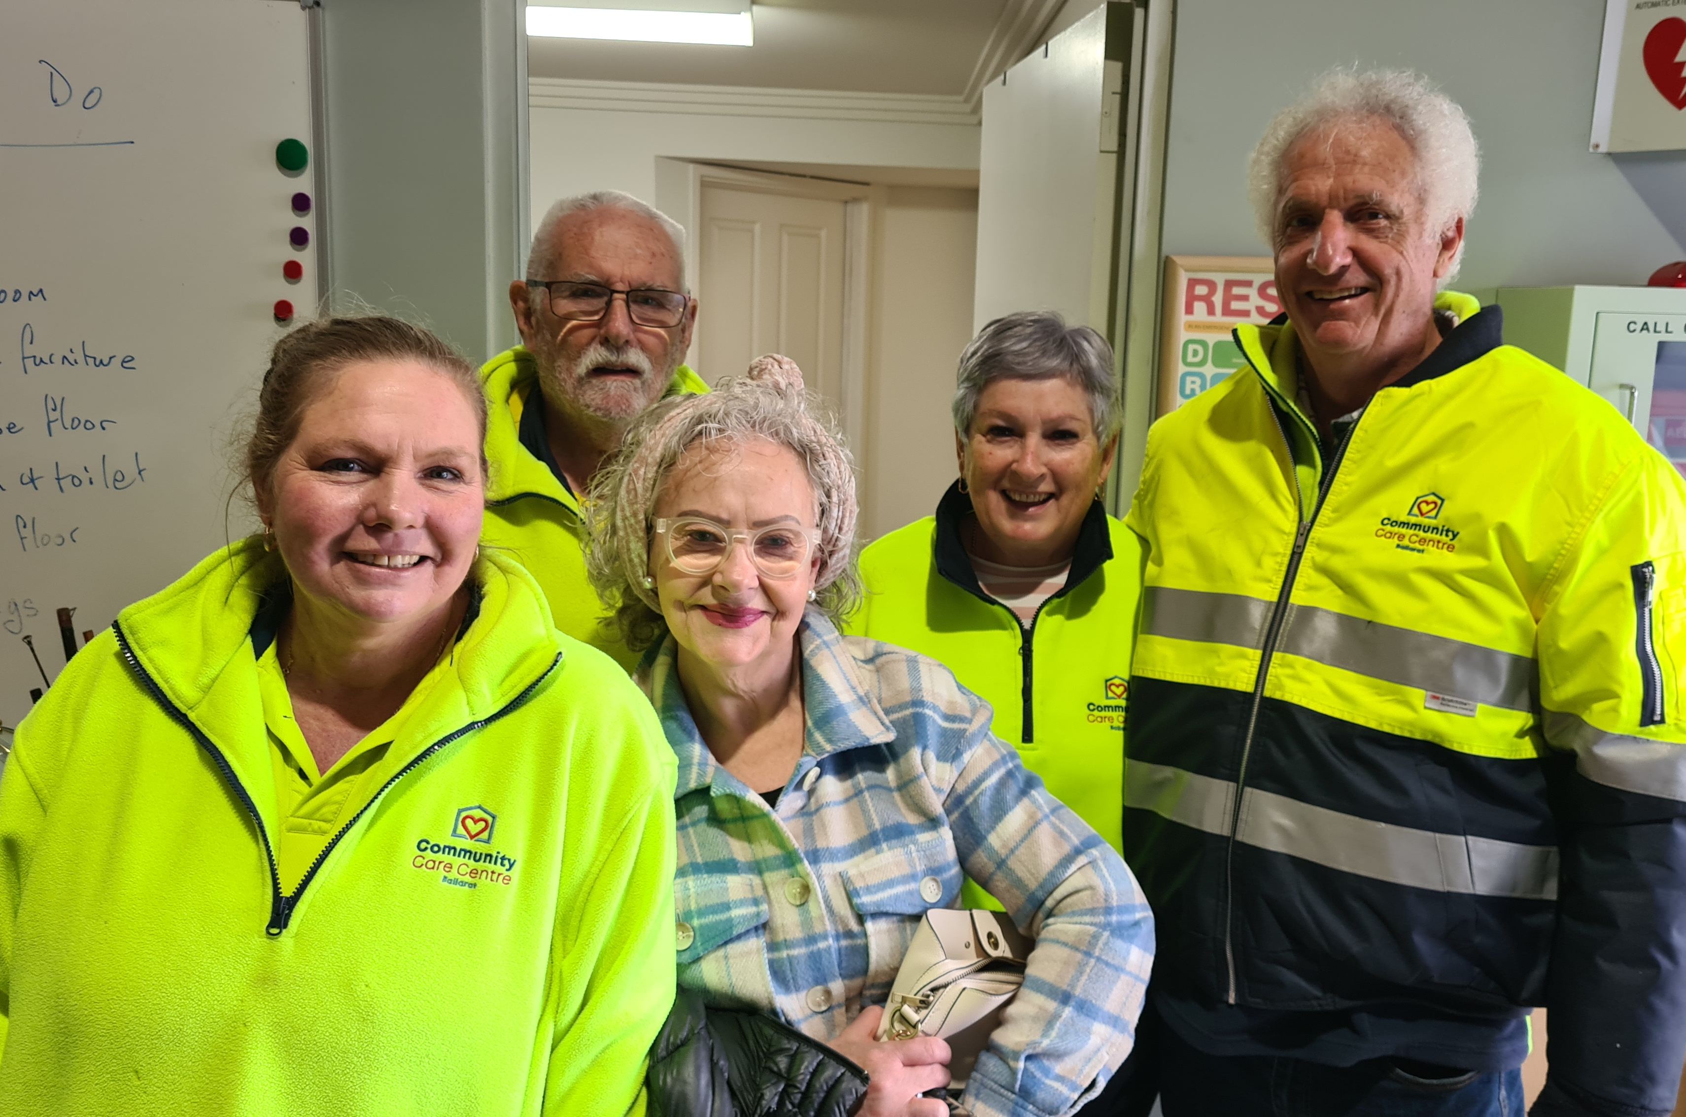
Thank you from us all
To Donors & Supporters
Rotary Clubs, businesses, grant bodies and philanthropic
To Volunteers & Staff
Thank you for hands-on effort and dedication
To Partners
For trusting us to support your clients

